Slide 1
IBM University Engagement Project Submission
“Exploring the Power of Agentic AI with IBM Granite and LangFlow”

Slide 2

Project Tile – Agentic AI for Mental Health Awareness & Suicide Prevention
Domain of Project – Healthcare
Student Name | Recent Passport Photo | Email ID | Mobile number [WhatsApp]
DEVEN GOL |  | Devengol.dce@charusat.ac.in | 7984792228

Slide 3
Problem Statement -Agentic AI for Mental Health Awareness & Suicide Prevention
The Challenge
Mental health issues such as depression, anxiety, and suicidal thoughts are growing worldwide. Stigma, lack of awareness, and limited access to timely help prevent many individuals from seeking support. Traditional systems are often reactive, leaving gaps in early detection and preventive care.
The Objective
Build an Agentic AI-powered Mental Health Awareness & Suicide Prevention Agent that is empathetic, proactive, and safe. The solution should:
Promote Awareness & Education – Share accessible resources on mindfulness, coping strategies, and self-care.
Enable Early Detection (RAG) – Use Retrieval-Augmented Generation to identify distress signals in conversations, journaling inputs, or safe online data.
Provide Empathetic Support – Build a conversational agent that listens actively and responds with empathy (with clear disclaimers: not a substitute for professional medical advice).
Predict & Prevent Risks – Forecast stress peaks, suggest preventive strategies, and issue alerts when high-risk signals are detected (with consent).
Connect to Human Support – Link users to helplines, counselors, or community support for timely intervention.

Slide 4
Technology Used
Tech Stack (Mandatory)
Use any one of the following approaches:
LangFlow + IBM watsonx.ai + Granite Models
IBM Cloud Agentic Lab with IBM Granite Models
Replicate with LangChain + RAG + IBM Granite Models
I used LangFlow + IBM watsonx.ai + Granite Models

Slide 5
Proposed Solution -
Proposed Solution: Agentic AI for Mental Health Awareness and Suicide Prevention
The proposed solution is a multi-agent AI-powered Mental Health Awareness and Suicide Prevention System built using LangFlow, IBM watsonx.ai, and Granite Models to provide personalized, proactive, and real-time mental health support. The system addresses critical challenges in mental health awareness, emotional well-being monitoring, early suicide risk detection, and timely intervention through an intelligent, modular architecture.
At its core, the solution utilizes a Retrieval-Augmented Generation (RAG) pipeline to access reliable mental health knowledge from trusted sources such as the World Health Organization (WHO), National Institute of Mental Health (NIMH), Centers for Disease Control and Prevention (CDC), and validated psychological wellness resources. This information is embedded and stored in a vector database, enabling the system to retrieve and generate accurate, context-aware responses related to mental health conditions, coping mechanisms, crisis support, and preventive care using Granite models.
The system consists of four key agents:
1. Mental Health Knowledge Agent
Retrieves and summarizes evidence-based mental health information using RAG.
2. Emotional Assessment Agent
Detects emotional states such as stress, anxiety, loneliness, hopelessness, sadness, or emotional distress.
Continuously monitors behavioral and emotional patterns to identify early warning signs.
3. Personalized Support & Recommendation Agent
Generates personalized wellness plans based on user emotional status, age group, lifestyle, and mental health needs.
4. Suicide Risk Detection & Crisis Intervention Agent
Performs risk assessment and classifies users into Low, Moderate, High, or Critical risk categories.
LangFlow is used to orchestrate agent workflows and manage inter-agent communication, while IBM watsonx.ai provides scalable model deployment, embeddings, governance, security, and responsible AI capabilities. Granite Models power advanced reasoning, sentiment understanding, emotional analysis, summarization, and personalized support generation.

Slide 6
Langflow component Used -
1) Chat Input – Interface where users enter their queries, preferences, or meal details (text/voice/image).
2) IBM watsonx AI Agent - Processes user input using Granite models to generate personalized nutrition insights and recommendations.
3) Name of IBM Granite model - Granite-4.0-8B-Instruct → Fast, efficient for real-time diet recommendations
4) Chat output -Displays AI-generated responses such as diet plans, nutritional analysis, and health suggestions.
5) File component - Stores and retrieves user interactions, emotional wellness records, mood logs, mental health assessments, crisis intervention history, and trusted mental health knowledge datasets for analysis, monitoring, and personalized support.

Slide 7
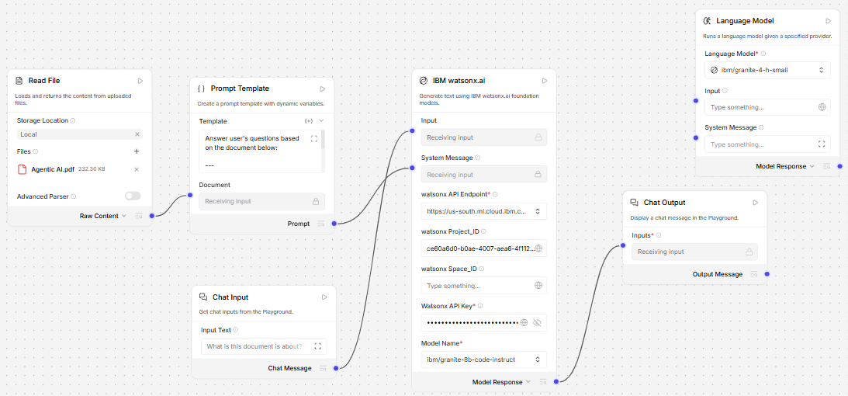
Langflow workflow -

Slide 8

Architecture blueprint

Slide 9

Role of Agentic AI in the solution
Role of Agentic AI in Nutrition Agent
Agentic AI enables the Nutrition Agent to function as an intelligent, autonomous system rather than a simple chatbot. Using IBM watsonx.ai and IBM Granite models, it coordinates multiple specialized agents to deliver personalized nutrition guidance.
Each agent performs a specific role—such as retrieving nutritional data, generating diet plans, providing health advice, and analyzing food logs—while working collaboratively. This multi-agent approach ensures efficient task execution and accurate results.
Agentic AI also brings context awareness, understanding user details like age, health conditions, and fitness goals to generate tailored recommendations. It supports real-time adaptation, continuously updating suggestions based on user inputs like daily meals.
Additionally, agents communicate with each other, enabling better decision-making and improved outcomes.
Overall, Agentic AI makes the system proactive, personalized, and goal-driven, acting like a smart digital nutritionist that helps users maintain a healthy lifestyle.

Slide 10
Technology Used
Langflow platform -For designing and orchestrating multi-agent workflows visually
IBM Grainte model - for eg – ibm-granite-3-2-8b – For natural language understanding, reasoning, and personalization
IBM Cloud – It provides the infrastructure to build, deploy, and scale the Nutrition Agent efficiently. IBM Cloud enables a reliable, secure, and scalable environment for deploying the Nutrition Agent.
RAG– RAG to fetch real data first, then generate intelligent answers, making the Nutrition Agent more trustworthy and effective.
IBM Watsonx.ai - For model deployment, embeddings, and AI governance
Vector Database (FAISS/Chroma) – For RAG-based nutritional data retrieval

Slide 11
Novelty and Uniqueness
The proposed Nutrition Agent stands out by combining Agentic AI, RAG, and personalization into a single intelligent system.
Multi-Agent Intelligence – Instead of a single chatbot, multiple specialized agents collaborate to deliver accurate and context-aware nutrition guidance.
RAG-Based Accuracy – Integrates real-time data retrieval with AI generation, reducing misinformation and ensuring trustworthy recommendations.
Hyper-Personalization – Tailors diet plans based on health conditions, cultural preferences, and fitness goals.
Real-Time Feedback Loop – Continuously adapts recommendations based on daily food logs and user behavior.
Multi-Modal Input – Supports text, voice, and image-based meal tracking for better usability.
Preventive Healthcare Focus – Goes beyond diet planning to provide disease-specific nutrition advice.
Scalable & Enterprise-Ready – Built on IBM watsonx.ai with IBM Granite models, ensuring reliability and governance.
This makes the solution a smart, adaptive, and proactive digital nutritionist, not just a static diet recommendation tool.

Slide 12
Git Hub Link
https://github.com/deven215/Langflow.git
·
·
·

Slide 13
Future Scope
1.Integration with Wearables & Health Devices –
The system can be integrated with smartwatches and fitness trackers to collect real-time data such as steps, calories burned, heart rate, and sleep patterns. This will enable the Nutrition Agent to provide more accurate and dynamic diet recommendations based on actual user activity and health metrics.
2.AI-Powered Voice Assistant & Multilingual Support –
Enhancing the system with a voice-enabled assistant and support for multiple languages will improve accessibility. Users can interact naturally in their preferred language, making the solution more inclusive and suitable for diverse populations, especially in regions with varied linguistic backgrounds.
·
·
·

Slide 14


